Slide 1
HBASE
By:
Thejaswini Reddy Vootkuri
Showrya Chakra Kollu
Satya Sandeep Kollipara
Gyaneshwar Malba

Slide 2



Slide 3
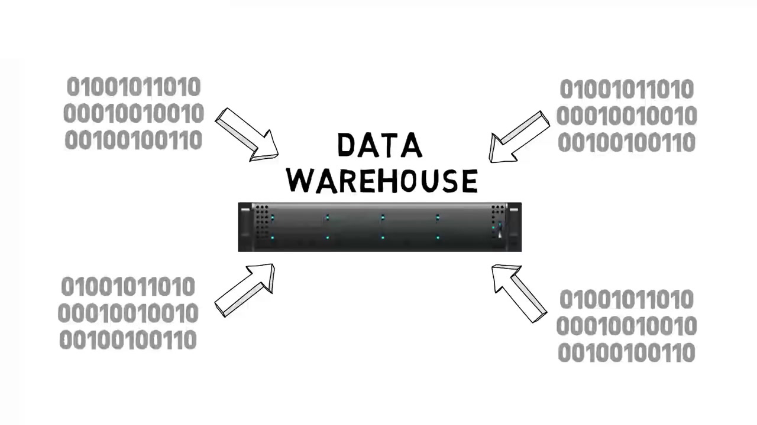
Traditional Data Warehouse

Slide 4

What If The Data Is Beyond The Size That A Traditional Data Warehouse Can Handle??

Slide 5
The Four V’s Of Big Data
Volume
Variety
Velocity
Variability

Slide 6
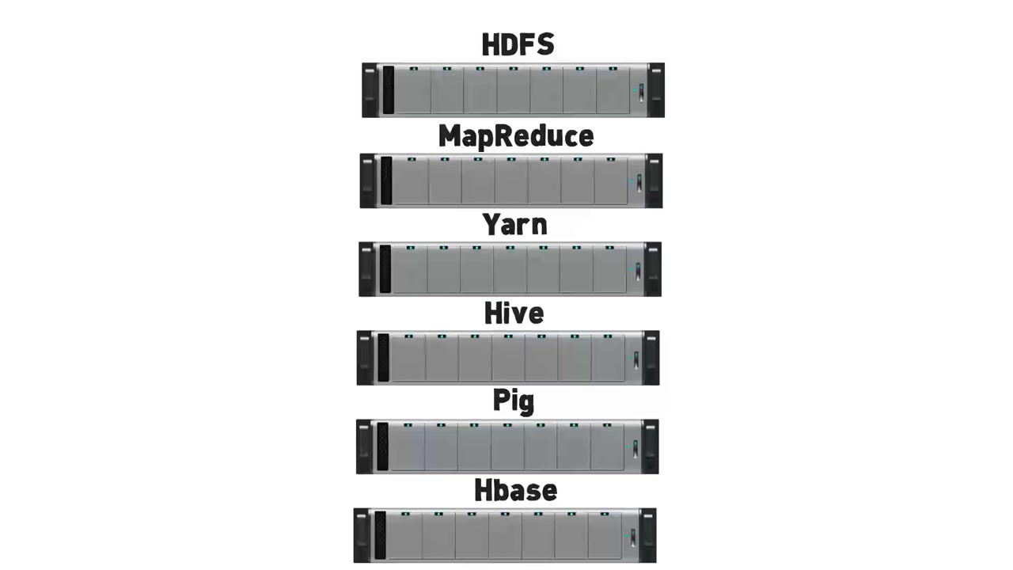
Major Components Of Hadoop Eco system

Slide 7
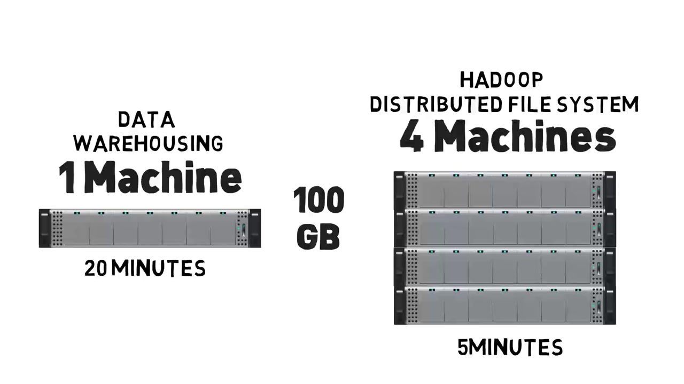
Principle of HDFS
HDFS

Slide 8
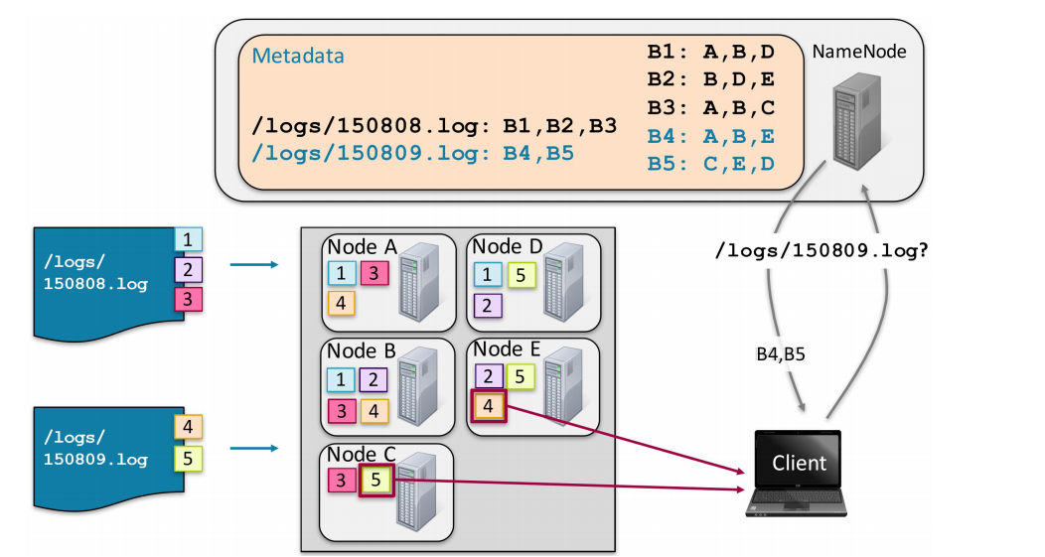
HDFS
HDFS

Slide 9
Contents Of Master Node
HDFS
Blocks of data that are present on the data node.
How many times the data files have been replicated.
How many data nodes constitute a name node.
Capacity of a name node and space utilization.

Slide 10
Contents Of Slave Node
HDFS
All the processing data that is stored on data nodes and deployed on each machine.
The actual storage for the files being processed.
Serving read and write requests for the clients.

Slide 11
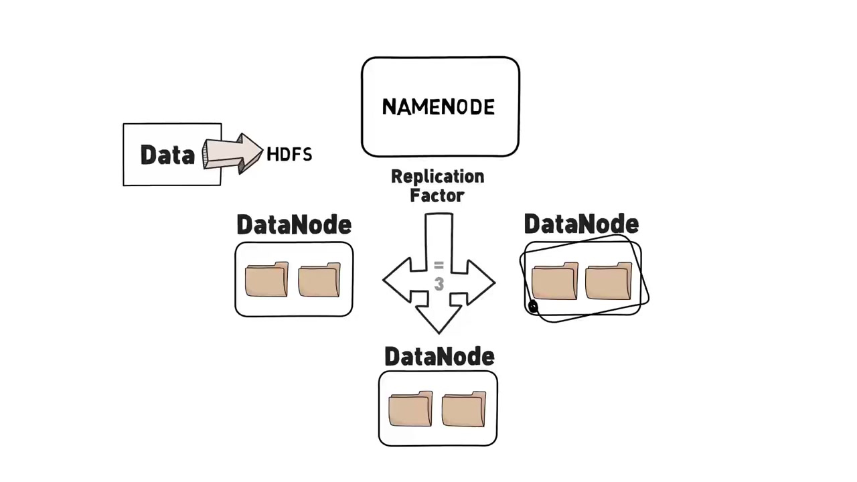
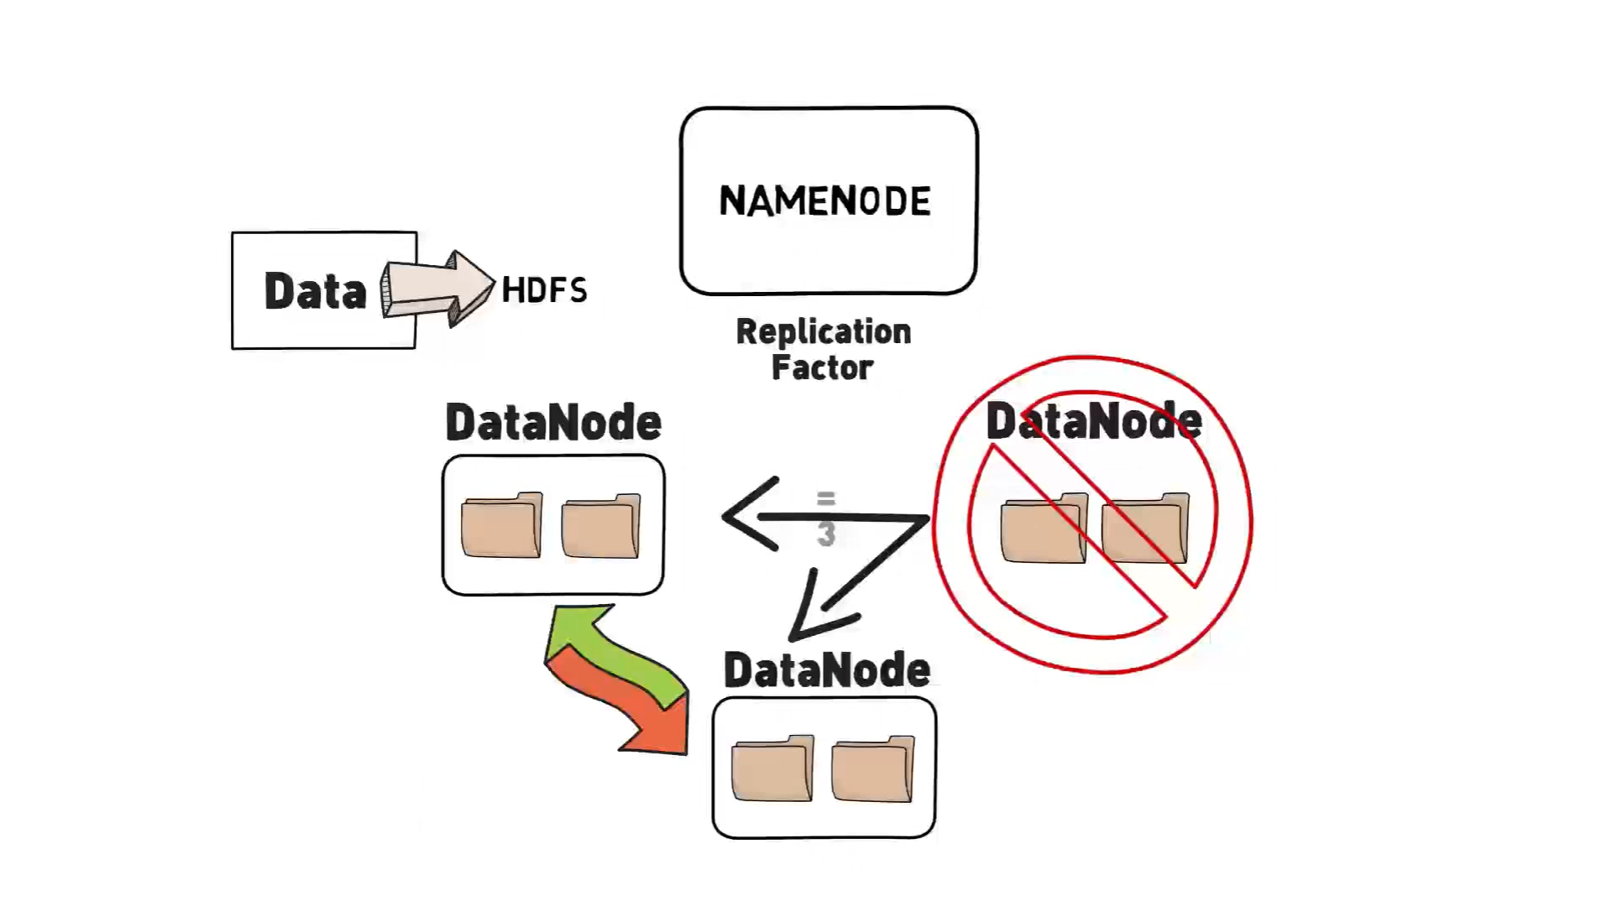
Working
HDFS

Slide 12
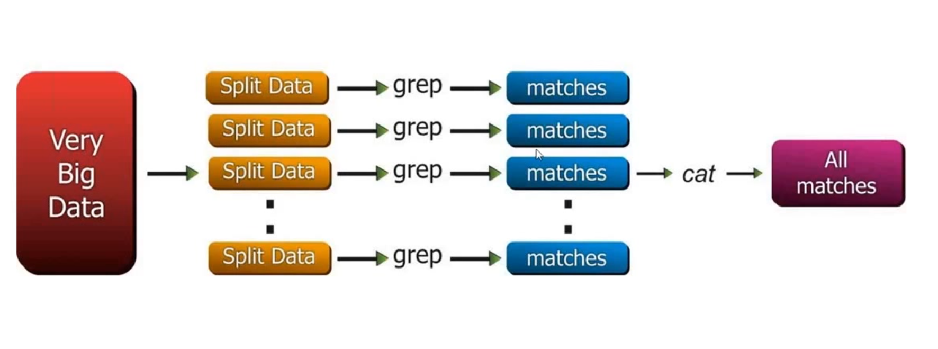
Traditional way of data processing
MAP
Reduce

Slide 13
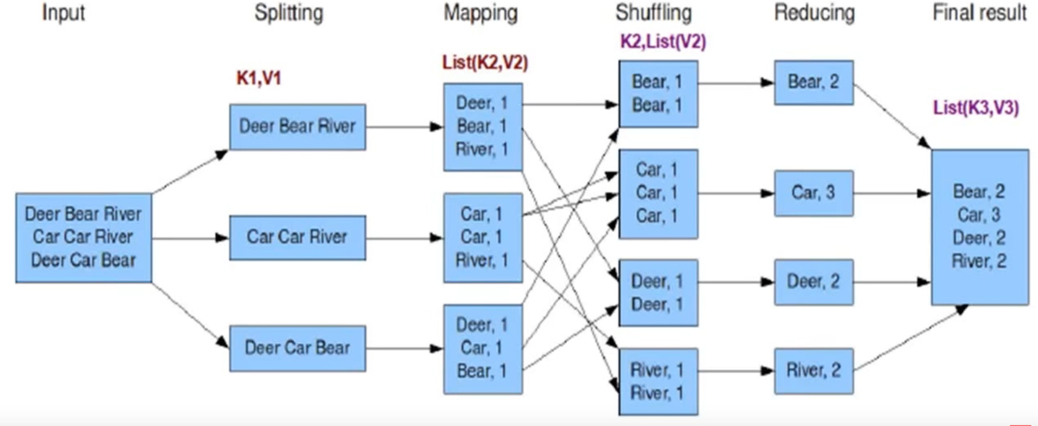
Map Reduce
MAP
Reduce

Slide 14
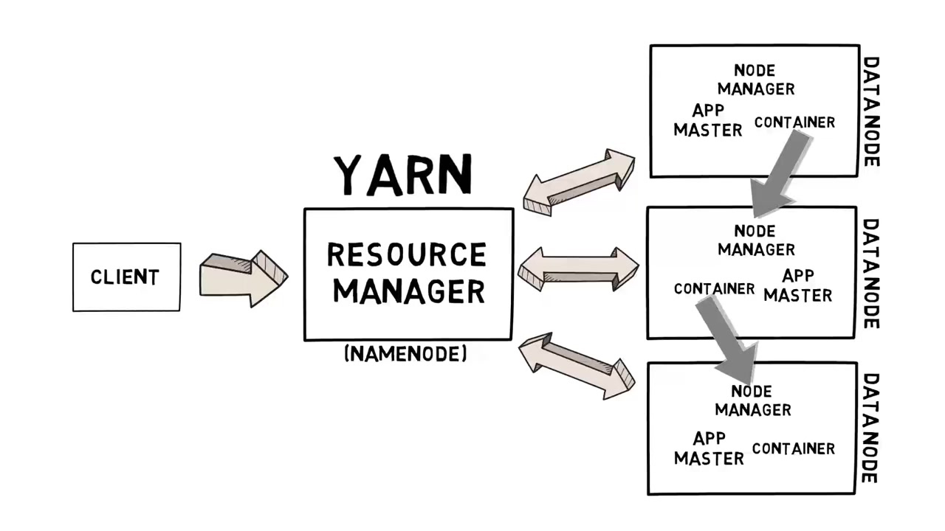
YARN
YARN

Slide 15
PIG & HIVE
PIG
HIVE
Programming languages.
GOAL: They ease the complexity of writing complex java MapReduce programs.

Slide 16

HBASE

Slide 17
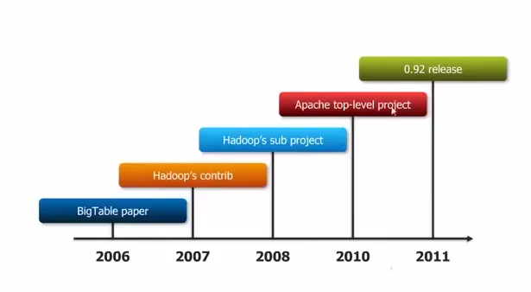
HISTORY
HBASE
In 2007, Mike Cafarella released a code for open source BIG TABLE implementation that he called HBASE.
It is available under the Apache Software License, version 2.0.

Slide 18
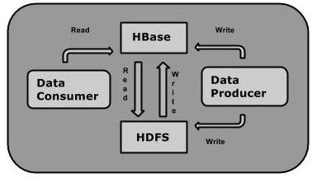
What is HBASE??
HBASE
Column-oriented key-value data store.
Open Source.
Built on top of HDFS.

Slide 19
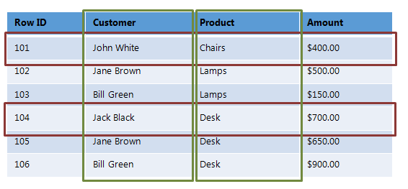
Column Oriented
HBASE
Data is stored and retrieved in columns and hence it can read only relevant data.

Slide 20
Advantages and Disadvantages
HBASE
Column-oriented
ADVANTAGES :
Faster aggregate calculation of single column
Higher compression(as stores similar data together)
DISADVANTAGES :
Inserting/Updating of single new record
Retrieval of single record

Slide 21
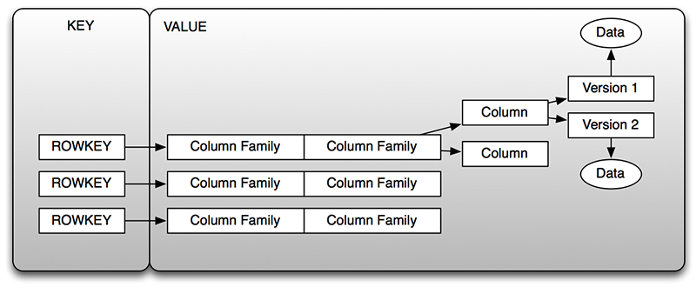
Key value data store
HBASE
Can retrieve the value associated with key

Slide 22
Advantages and Disadvantages
Key value data store
ADVANTAGES :
Very fast
Very scalable
Able to distribute horizontally
DISADVANTAGES :
Many data structures cannot be easily modeled as key value pairs.

Slide 23
Type of database?
HBASE
Does not support SQL scripting.
NOSQL database.
Written in Java employing similarity with MapReduce application.

Slide 24
HBASE DATA MODEL:
Table
Row
Column family
Column qualifier
Cell
Timestamp

Slide 25
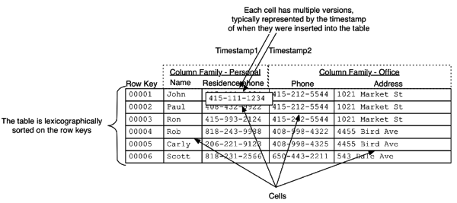

Slide 26
Features Of HBase Database
HBASE
HBase is linearly scalable.
It has automatic failure support.
It integrates with Hadoop, both as a source and a destination.
It has easy java API for client.
It provides data replication across clusters.

Slide 27
HBase Run Modes
HBASE
HBase can run in 2 modes:
Standalone HBase.
Distributed:
Pseudo-distributed mode
Fully-distributed mode

Slide 28
HBase Architecture
HBASE
Master-Slave relationship.
HBase cluster has :
One master node called HMaster.
Multiple region servers called HRegionServer.
Each region server has multiple regions HRegions.

Slide 29
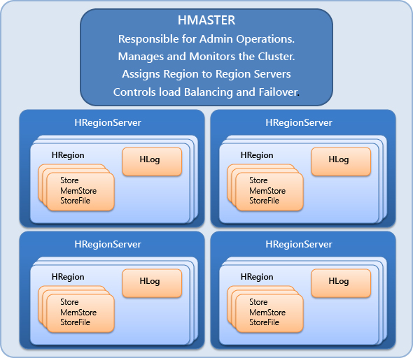
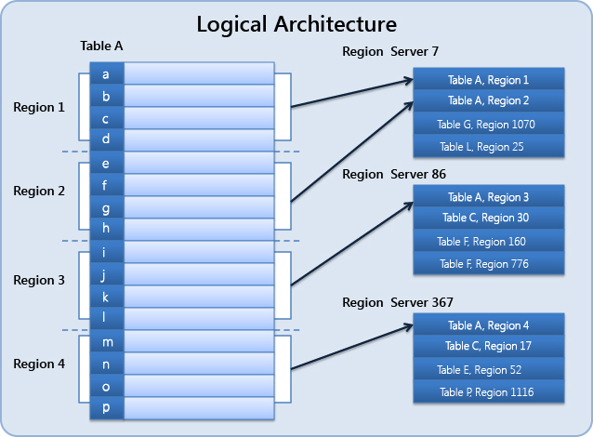
Hbase Architecture
HBASE

Slide 30
HBASE
Zookeeper
Meta Table

Slide 31
HBASE
HBase is distributed, replicated and automatically sharded.

Slide 32
HBASE IS
HBASE
Sorted: Key value pairs are kept in a sorted order.
Sparse: This follows from the fact the HBase stores key -> value mappings and that a "row" is nothing more than a grouping of these mappings (identified by the rowkey mentioned above). Unlike NULL in most relational databases, no storage is needed for absent information, there will be just no cell for a column that does not have any value.
Multidimensional: All data versioned using time stamp.

Slide 33
HBASE
When Should I Use HBase?

Slide 34





Who uses Hbase
HBASE
Facebook
Adobe
Twitter
Yahoo
Netflix

Slide 35
Difference between HBase and RDBMS
HBase | Relational Database
It is schema-less | It is a schema based database
It is a column-oriented data store | It is both row & column oriented data store
It is used to store de-normalized data | It is used to store normalized data
It contains sparsely populated tables | It contains thin tables
Automated partitioning is done in HBase | There is no such provision or built-in support for partitioning

Slide 36
Compression
HBASE
By using compression, the data occupies less space on disk.
Thus the process of reading data has to take place on smaller, compressed data size.
This leads to increased performance of reads.

Slide 37
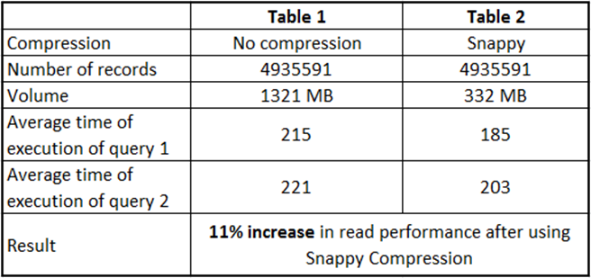
Compession algorithms
HBASE
LZO
GZIP
SNAPPY

Slide 38
HBase implementation
HBASE
Open jdk is needed.
Runs on top of Hadoop
HBase shell.

Slide 39
Hbase is not ACID complaint DB
Consistency
Availability
Partitioning tolerance

Slide 40
CRUD operations using Hbase shell
HBASE
Create table:
Syntax: create ‘<table name>’, ‘<colfamily1>’, ‘<colfamily2>’
Example: hbase(main):002:0> create 'emp', 'personal data', ’professional data’
0 row(s) in 1.1300 seconds => Hbase::Table - emp
Insert data:
Syntax: put ’<table name>’,’row1’,’<colfamily:colname>’,’<value>’
Example:
hbase(main):005:0> put 'emp','1','personal data:name','raju‘
0 row(s) in 0.6600 seconds
hbase(main):006:0> put 'emp','1','personal data:city','hyderabad'
0 row(s) in 0.0410 seconds
hbase(main):007:0> put 'emp','1','professional data:designation','manager'
0 row(s) in 0.0240 seconds
hbase(main):007:0> put 'emp','1','professional data:salary','50000'
0 row(s) in 0.0240 seconds

Slide 41
HBASE
Update data:
Syntax: put ‘table name’,’row ’,'Column family:column name',’new value’
Example:
hbase(main):002:0> put 'emp','row1','personal:city','Delhi'
0 row(s) in 0.0400 seconds

Slide 42
HBASE
Read data:
Syntax: get ’<table name>’,’row1’
Example:
hbase(main):012:0> get 'emp', '1'
COLUMN CELL
personal : city timestamp = 1417521848375, value = hyderabad
personal : name timestamp = 1417521785385, value = ramu
professional: designation timestamp = 1417521885277, value = manager
professional: salary timestamp = 1417521903862, value = 50000
4 row(s) in 0.0270 seconds

Slide 43
HBASE
Delete data:
Syntax: delete ‘<table name>’, ‘<row>’, ‘<column name >’, ‘<time stamp>’
Example:
hbase(main):006:0> delete 'emp', '1', 'personal data:city', 1417521848375
0 row(s) in 0.0060 seconds

Slide 44
CRUD operations using Restful API
HBASE
POST: create a new table or replaces the existing table schema with specified
Example:
curl -vi -X POST \ -H "Accept: text/xml" \
-H "Content-Type: text/xml" \
-d '<?xml version="1.0" encoding="UTF-8"?><TableSchema name="users"><ColumnSchema name="cf" /></TableSchema>' \
"http://example.com:20550/users/schema"
GET:
Example:
curl -vi -X GET \ -H "Accept: text/xml" \ "http://example.com:20550/users/row1"

Slide 45
HBASE
curl -vi -X PUT \ -H "Accept: text/json" \ -H "Content-Type: text/json" \ -d '{"Row":[{"key":"cm93NQo=", "Cell": [{"column":"Y2Y6ZQo=", "$":"dmFsdWU1Cg=="}]}]}'' \ "example.com:20550/users/fakerow"
Put:
Example:
curl -vi -X PUT \ -H "Accept: text/json" \
-H "Content-Type: text/json" \
-d '{"Row":[{"key":"cm93NQo=", "Cell": [{"column":"Y2Y6ZQo=", "$":"dmFsdWU1Cg=="}]}]}'' \ "example.com:20550/users/fakerow"
Delete: Delete the table
Example:
curl -vi -X DELETE \
-H "Accept: text/xml“ \
"http://example.com:20550/users/schema"

Slide 46
References
https://www-01.ibm.com/software/data/infosphere/hadoop/hbase/
http://hbase.apache.org/
https://intellipaat.com/tutorial/hbase-tutorial/installation/

Slide 47


